Slide 1
The role of tutors, students and technology in learning support provision
Workshop W3 at the international event
Excellent Education for All
Mama Shelter, Prague, 25.4.2024
MSLS Net team

Slide 2
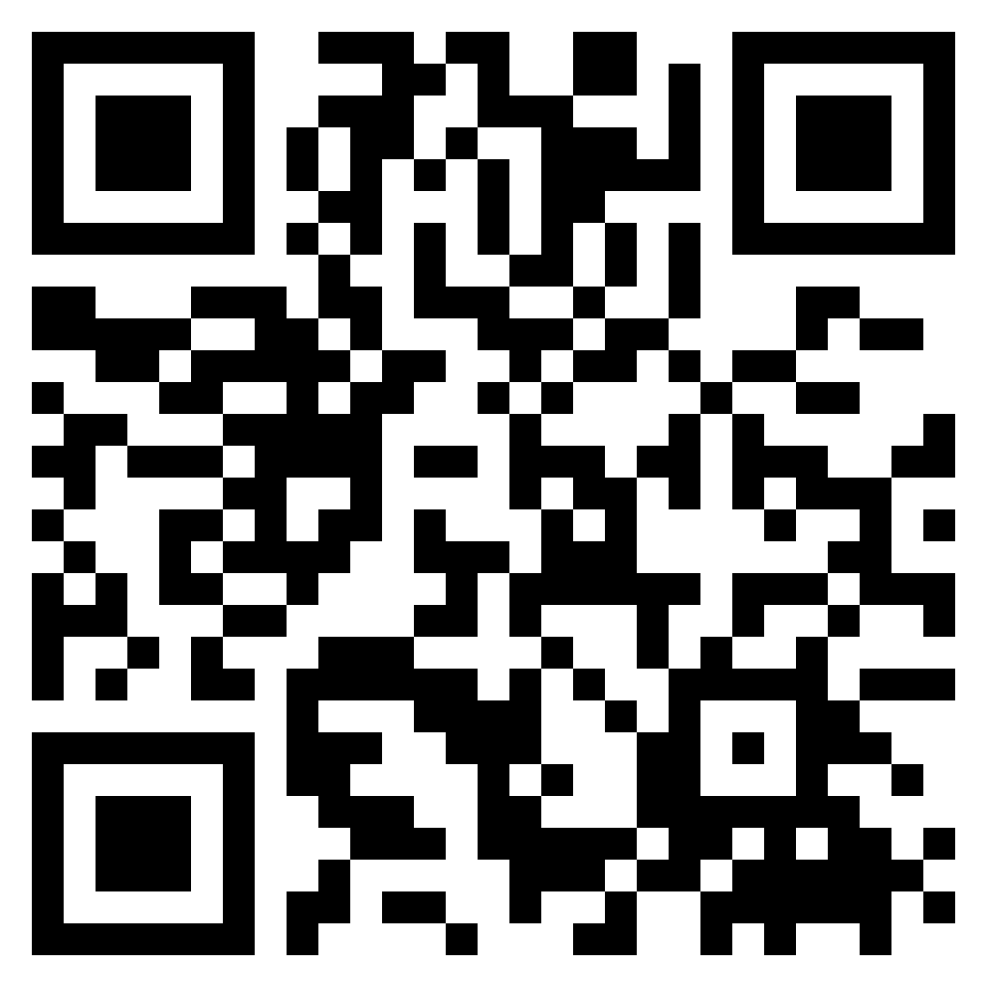
Program of the workshop
1 Concept of the learning support
2 Project info: „Capacity Building in Mathematics and Statistics Learning Support in Norway and the Czech Republic (MSLS Net)“
3 Quiz competition: Different aspects of the learning support provision
4 Video feedback from an experienced tutor/coordinator
5 Tutorial: Using Discord for supporting remote learners and building a learning community
6 Q&A, feedback
Workshop page:
https://msls-net.ceitec.cz/en/text/detail/135

Slide 3
1 What is „learning support“?
„Any extra, optional, non-compulsory programme or facility that assists students in developing (mathematical and/or statistical) confidence and skills during their enrolled study in a degree course, whether undergraduate or postgraduate, but with no credit associated with the learning support programme.“
Helps students to achieve their potential in a safe environment
Benefits:
Vital contribution: it is both important and acceptable to identify mathematical weaknesses, and to seek and accept help
MSLS facilitates the development of confidence in own mathematical and statistical skills
MSLS helps building mathematical and statistical fitness, confidence and transferability, all with reference to specific courses being taken by the students and/or real life

Slide 4
2 Project info
8/2021 – 7/2023 (2 years)
Objective: to improve the cooperation between the Czech Republic and Norway in the area of learning support for mathematics and statistics in higher education institutions
Outputs
training materials for an introductory course for staff providing mathematics and statistics support („tutors“), including remote support
handbook on good practices describing how to set up, manage and maintain Mathematics Support Centres
5 partners

Slide 5
Partners
Brno University of Technology
Masaryk University
Tomas Bata University in Zlin
The Arctic University of Norway
University of Agder

Slide 6
Outputs
https://msls-net.ceitec.cz/en/text/detail/130
Interactive scenarios
DOs and DON‘Ts
Video tutorials and experience
Training resources guide
Handbook of Good Practice
Part 1: The Essence of Support Centres
Part 2: Case Studies

Slide 7
3 Quiz/competition
Topic: Aspects of the learning support provision
Make a pair with your neighbour
Open https://nearpod.com
Enter the code you found on the workshop page
Follow the instructions that appear
...
Collect the prize ☺

Slide 8
4 Video feedback
Topic: Feedback from a former student tutor and the coordinator of an on-campus drop-in support service
Martin Nordskog (University of Agder)
Question 1: What can students expect from visiting a support centre?
Question 4: What is the ideal support strategy?
https://msls-net.ceitec.cz/file/download/283

Slide 9
5 Discord tutorial
Topic: Using Discord for supporting remote learners and building a learning community
Tørris Koløen Bakke, Arlene Hall (The Arctic University of Norway)
Download the Discord app (https://discord.com)
Follow the instructions on the workshop page
If you need help ask the „tutors“ ☺

Slide 10
6 Questions
Any questions?
Please give us your feedback
Also possible on Discord: channel „feedback-and-discussions“ in section „MSLS-NET WORKSHOP“ (until 2nd May 2024)

Slide 11
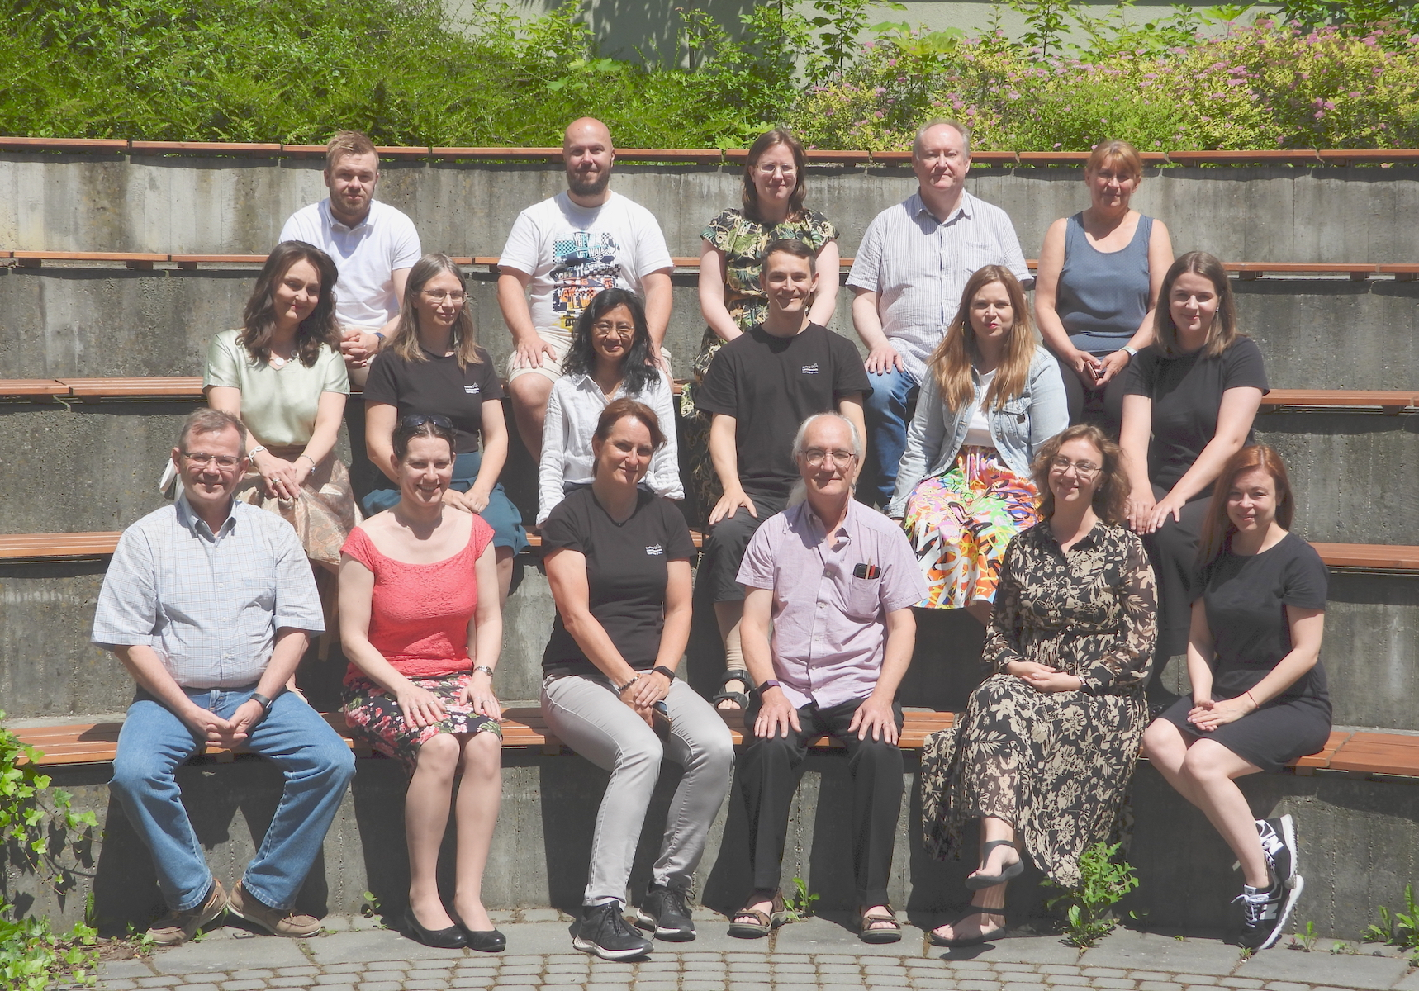
Thank you for joining us!

